Slide 1
Curso de ANSYS
UFES, 2019/1
AULA 07.a
AUTOR: Felipe Barbosa Teixeira
felipebarbosateixeira@gmail.com

Slide 2
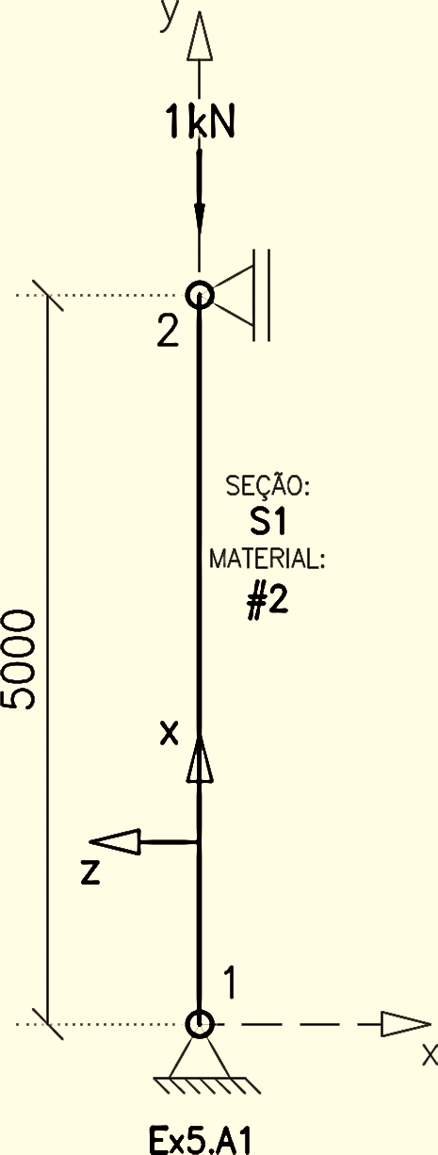
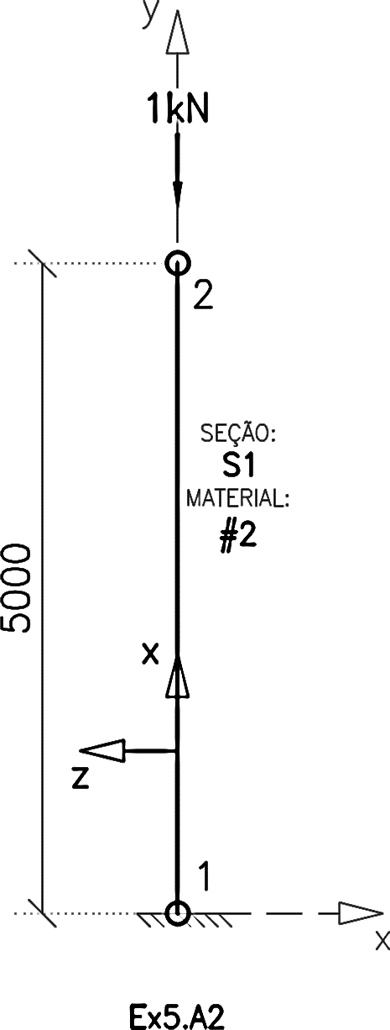
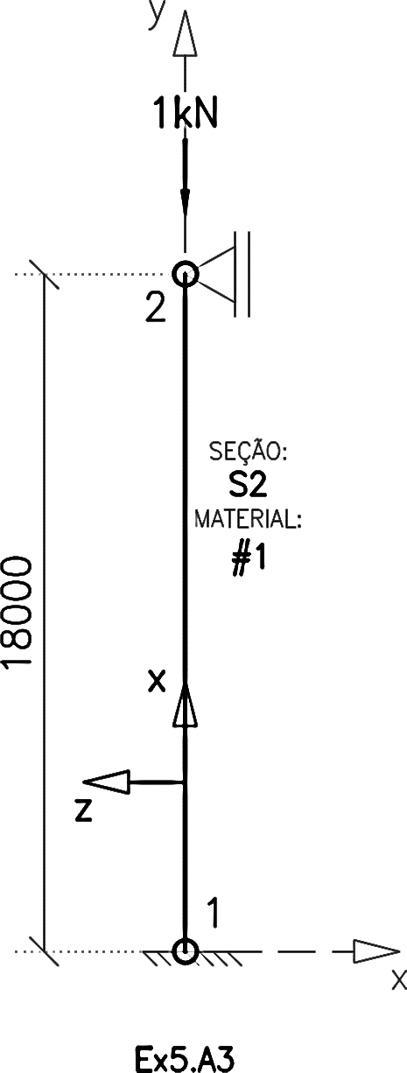
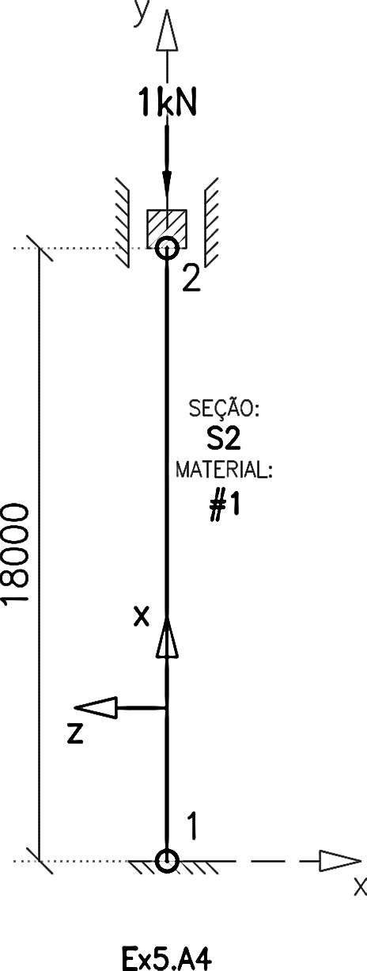
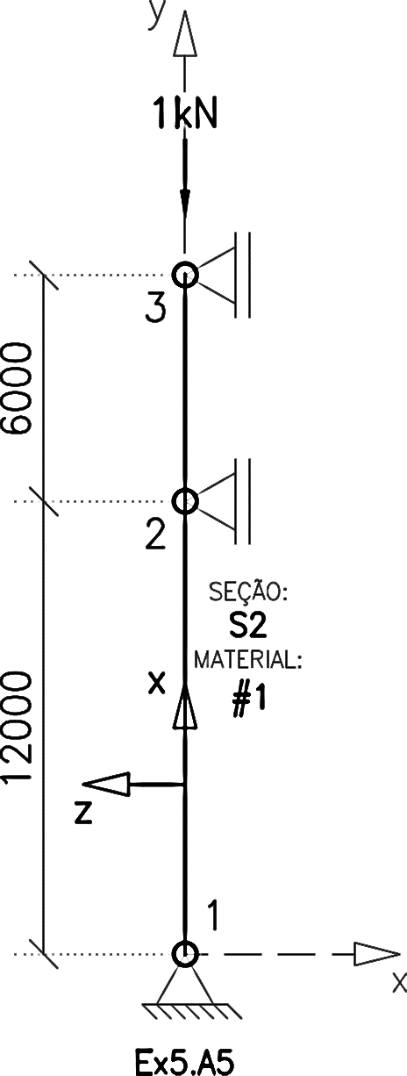
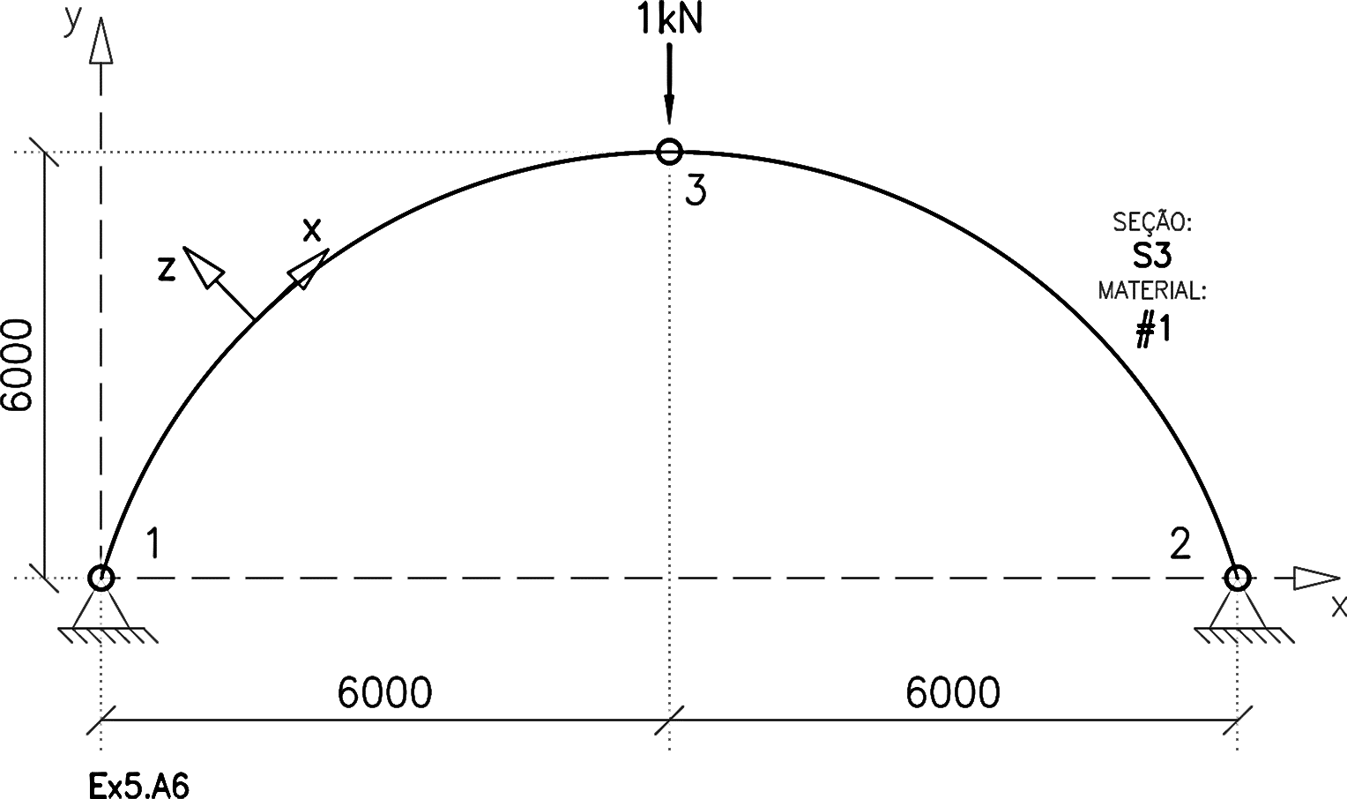
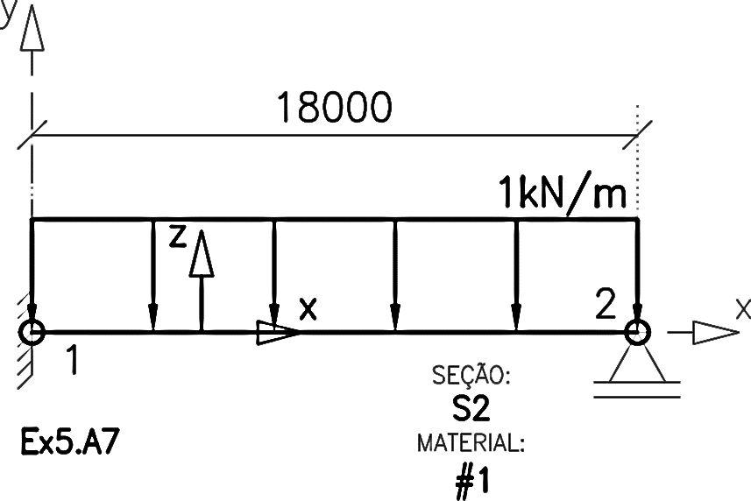

Slide 3
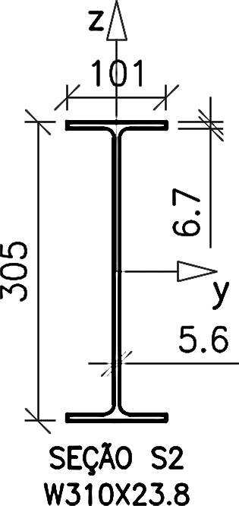
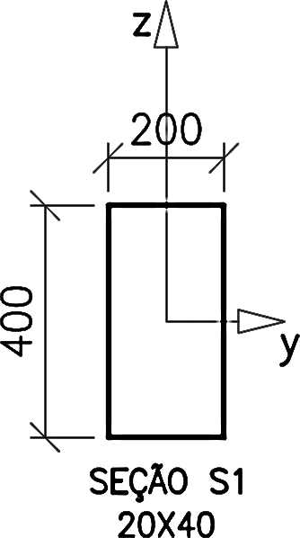


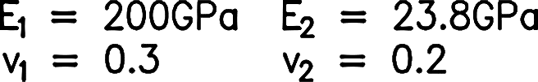
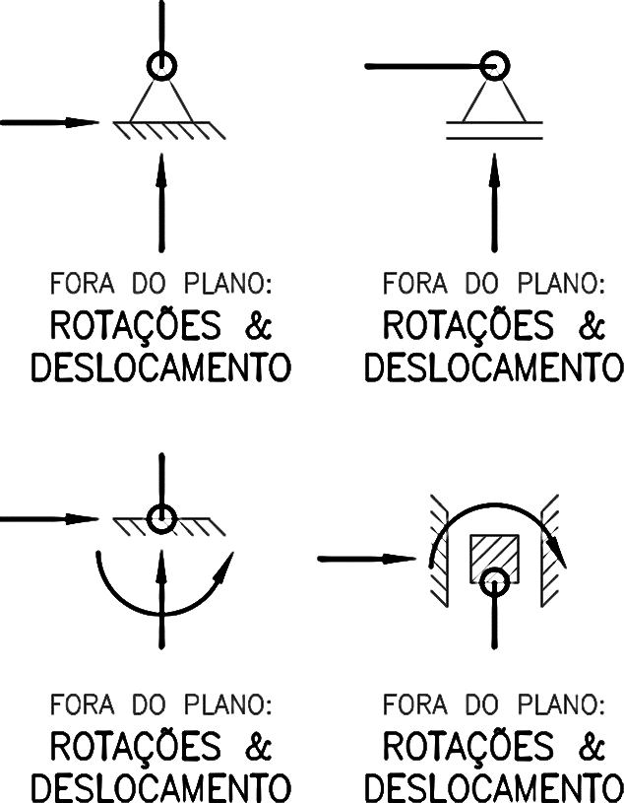
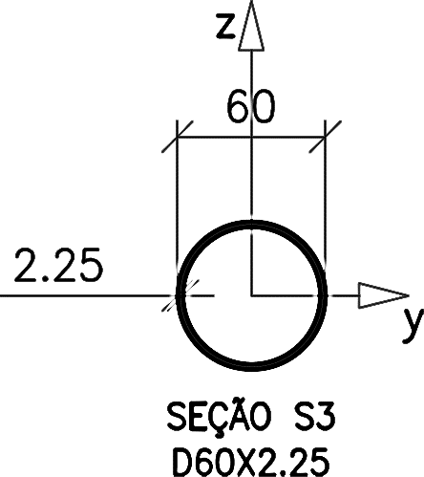

Slide 4
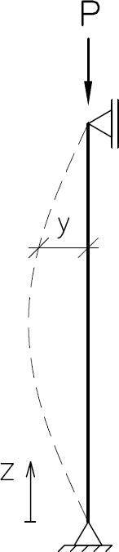
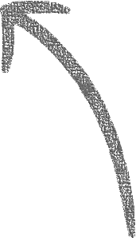
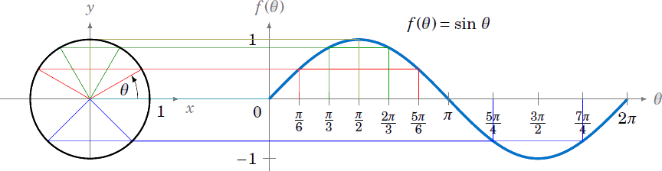
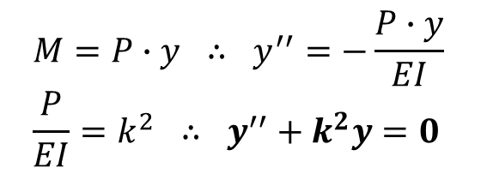
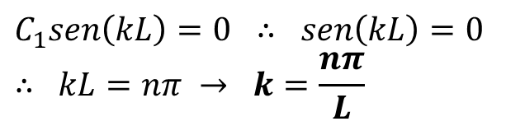
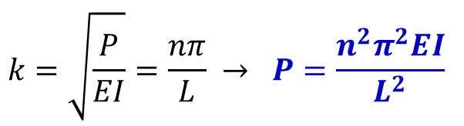
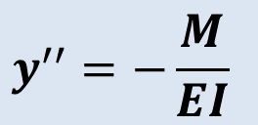
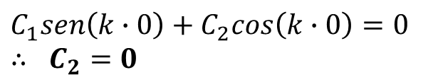
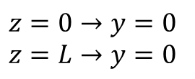


$$y^{′′}=−\frac{M}{EI}$$
$$k=\sqrt{\frac{P}{EI}}=\frac{nπ}{L} → P=\frac{n^{2}π^{2}EI}{L^{2}}$$
$$M=P∙y ∴ y^{′′}=−\frac{P∙y}{EI} \\ \frac{P}{EI}=k^{2} ∴ y^{′′}+k^{2}y=0$$
$$y=C_{1}sen\left(kz\right)+C_{2}cos(kz)$$
$$y=C_{1}sen\left(\frac{nπz}{L}\right)$$
$$z=0→y=0 \\ z=L→y=0$$
$$C_{1}sen\left(k∙0\right)+C_{2}cos\left(k∙0\right)=0 \\ ∴ C_{2}=0$$
$$C_{1}sen\left(kL\right)=0 ∴ sen\left(kL\right)=0 \\ ∴ kL=nπ → k=\frac{nπ}{L}$$

Slide 5
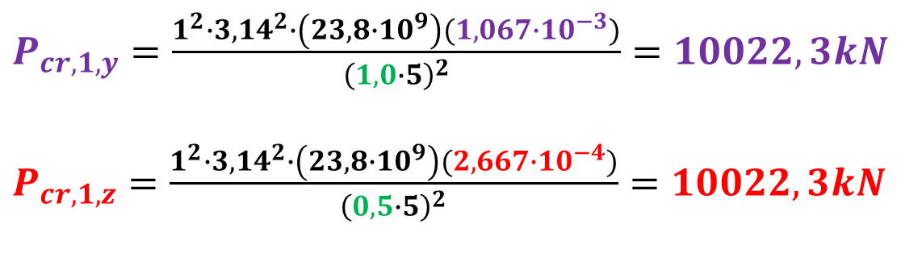
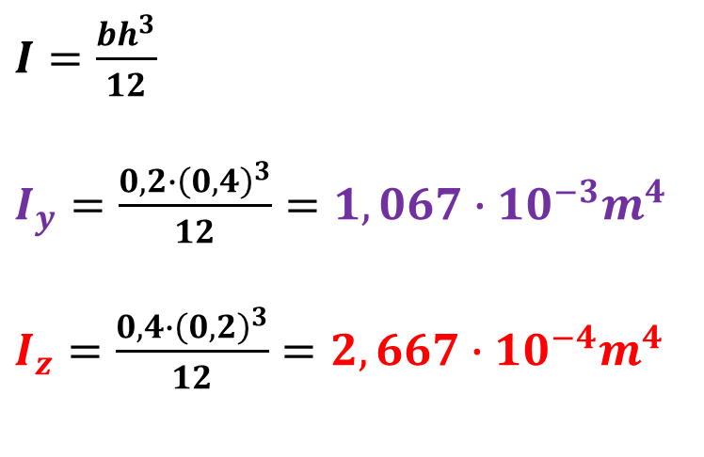
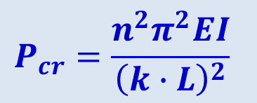
$$P_{cr}=\frac{n^{2}π^{2}EI}{{\left(k∙L\right)}^{2}}$$
$I=\frac{bh^{3}}{12}$
$I_{y}=\frac{0,2∙{\left(0,4\right)}^{3}}{12}=1,067∙10^{−3}m^{4}$
$I_{z}=\frac{0,4∙{\left(0,2\right)}^{3}}{12}=2,667∙10^{−4}m^{4}$
$P_{cr,1,y}=\frac{1^{2}∙3,14^{2}∙\left(23,8∙10^{9}\right)(1,067∙10^{−3})}{{\left(1,0∙5\right)}^{2}}=10022,3kN$
$P_{cr,1,z}=\frac{1^{2}∙3,14^{2}∙\left(23,8∙10^{9}\right)(2,667∙10^{−4})}{{\left(0,5∙5\right)}^{2}}=10022,3kN$

Slide 6
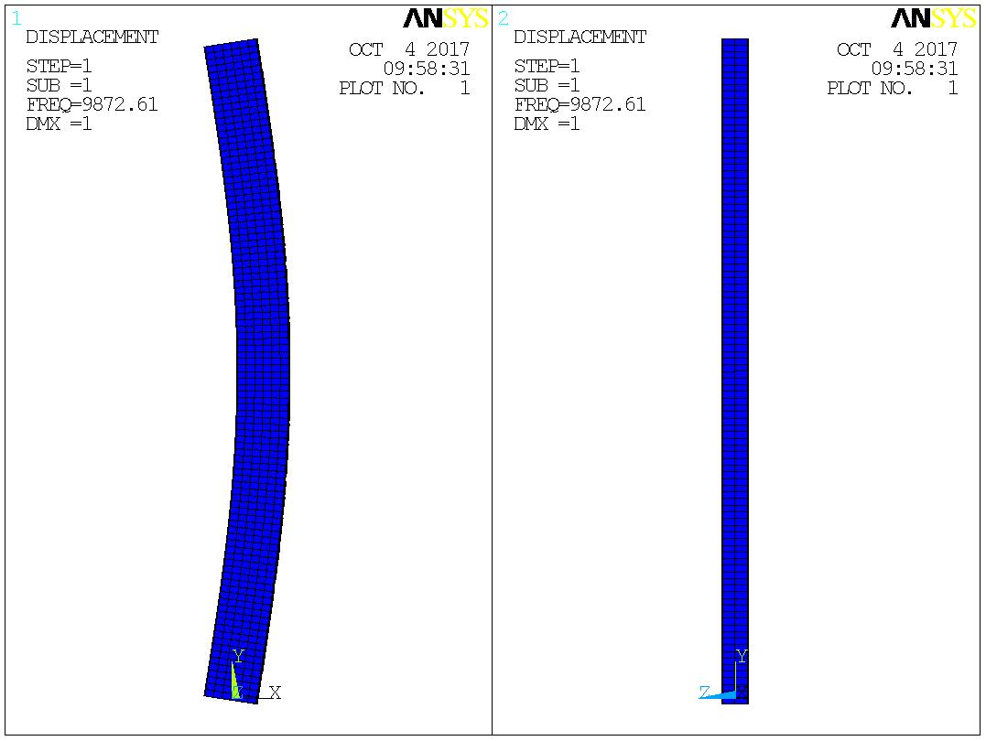
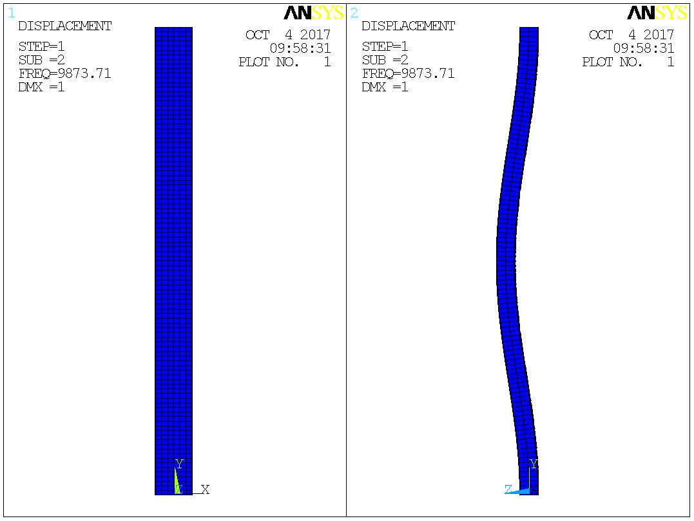





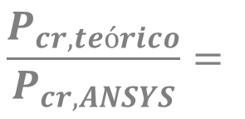

$$P_{cr,1,y}=10.022kN$$
$$P_{cr,1,z}=10.022kN$$
$$P_{ANSYS,1}=9.872kN$$
$$P_{ANSYS,2}=9.873kN$$
$$\frac{P_{cr,teórico}}{P_{cr,ANSYS}}=$$
$$101,52\%$$
$$101,51\%$$

Slide 7
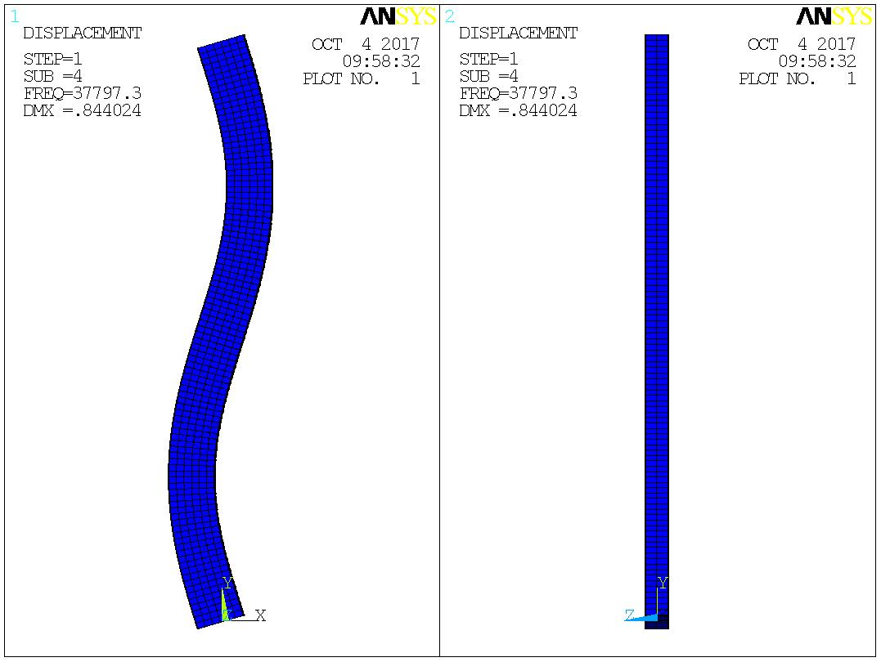
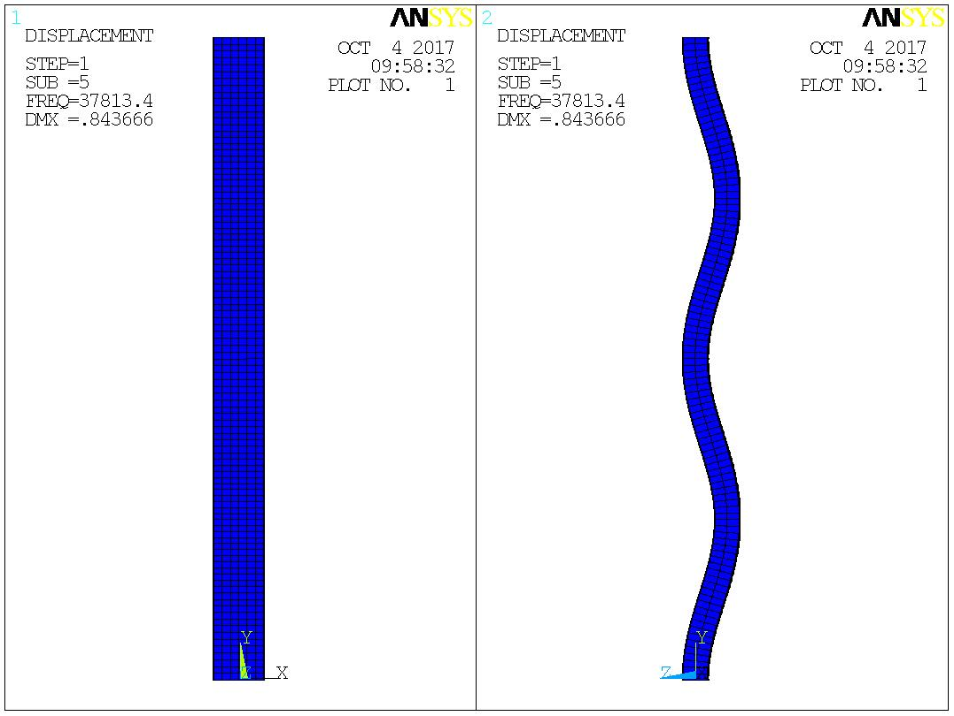






$$P_{cr,2,y}=40.089kN$$
$$P_{cr,2,z}=40.089kN$$
$$P_{ANSYS,4}=37.797kN$$
$$P_{ANSYS,5}=37.813kN$$
$$\frac{P_{cr,teórico}}{P_{cr,ANSYS}}=$$
$$106,06\%$$
$$106,02\%$$

Slide 8
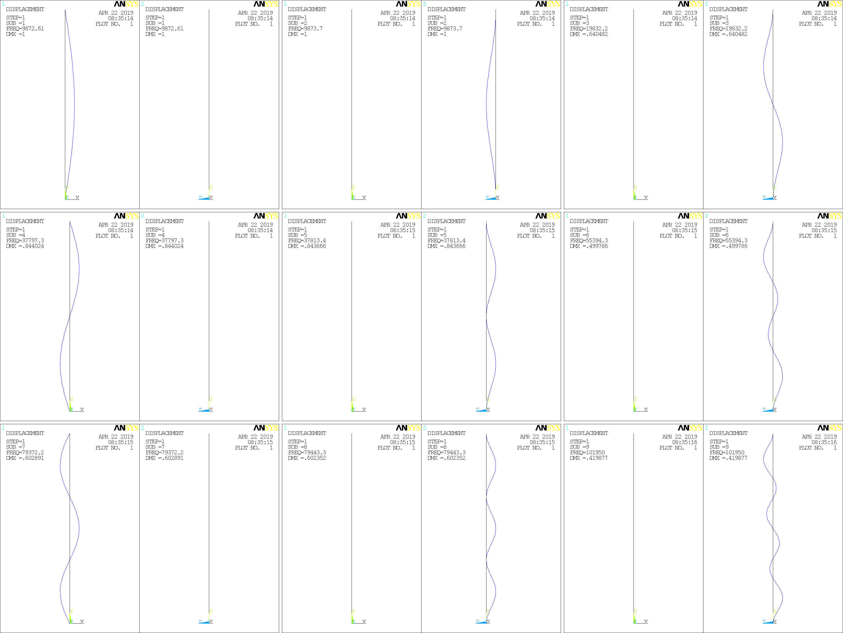
SUB=1
SUB=2
SUB=3
SUB=4
SUB=5
SUB=6
SUB=7
SUB=8
SUB=9

Slide 9
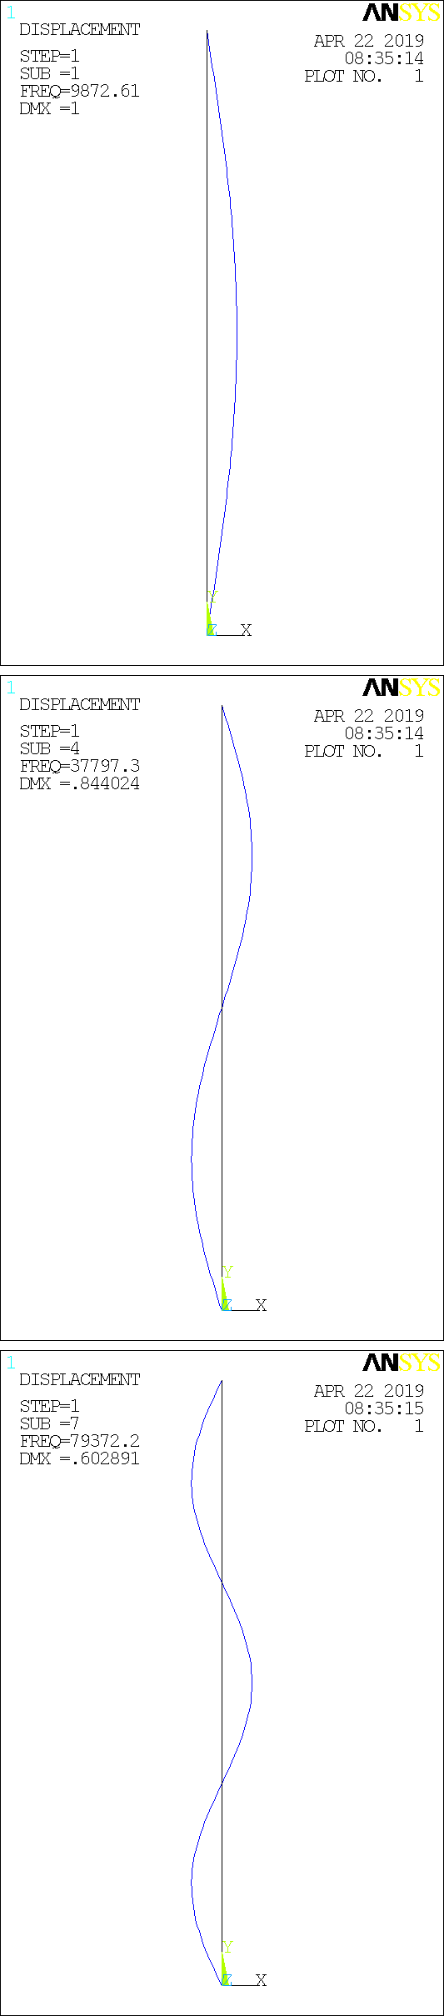
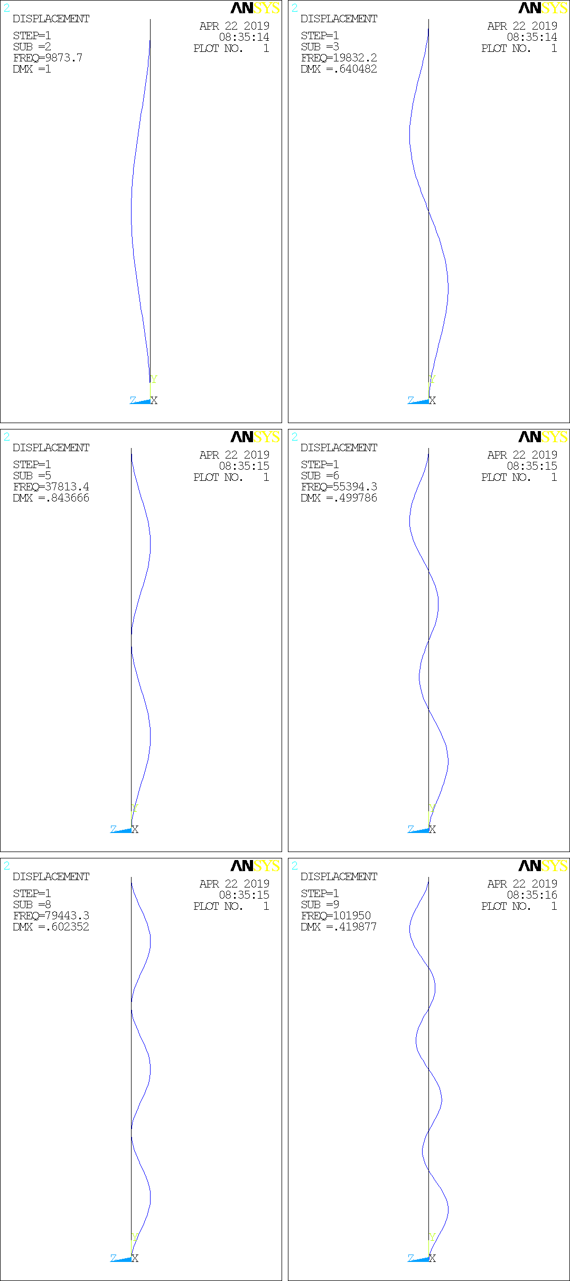
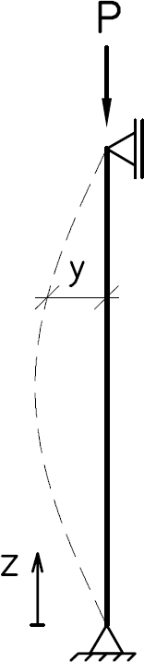
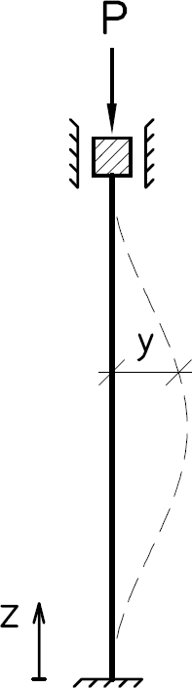
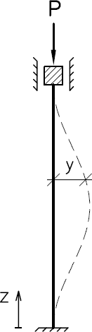



n=1
n=1
n=2
n=2
n=3
n=4
Cargas críticas:
Cargas críticas:
P_{cr} [MN]
# | ANSYS | TEÓRICA
1 | 9,87 | 10,0
2 | 19,8 | 40,1
3 | 37,8 | 90,2
4 | 55,3 | 160,4
5 | 79,4 | 250,6
6 | 101,9 | 360,8
$$P=\frac{n^{2}π^{2}EI}{L^{2}}$$
$$P=\frac{n^{2}π^{2}EI}{{(kL)}^{2}}$$
Linha elástica:
Linha elástica:
$$y=C_{1}sen\left(\frac{nπz}{L}\right)$$
?
n=3
n=5
n=6

Slide 10
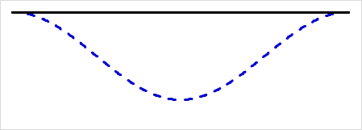
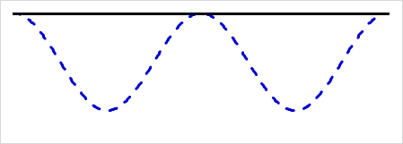
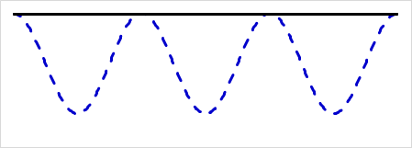

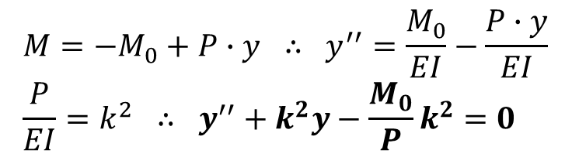
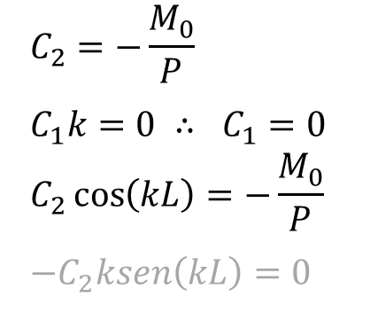

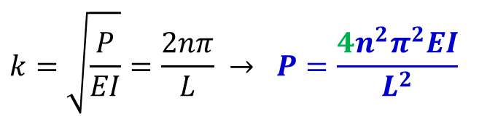
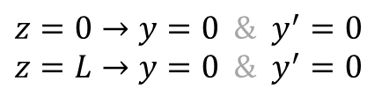
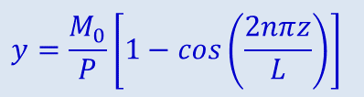
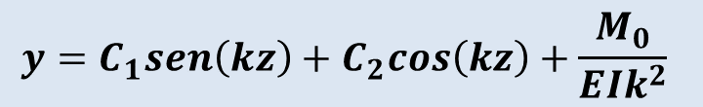
$$y^{′′}=−\frac{M}{EI}$$
$$k=\sqrt{\frac{P}{EI}}=\frac{2nπ}{L} → P=\frac{{4n}^{2}π^{2}EI}{L^{2}}$$
$$M={−M}_{0}+P∙y ∴ y^{′′}=\frac{M_{0}}{EI}−\frac{P∙y}{EI} \\ \frac{P}{EI}=k^{2} ∴ y^{′′}+k^{2}y−\frac{M_{0}}{P}k^{2}=0$$
$$y=C_{1}sen\left(kz\right)+C_{2}cos\left(kz\right)+\frac{M_{0}}{EIk^{2}}$$
$$y=\frac{M_{0}}{P}\left[1−cos\left(\frac{2nπz}{L}\right)\right]$$
$$z=0→y=0 \& y^{′}=0 \\ z=L→y=0 \& y^{′}=0$$
n=1
n=2
n=3
$$C_{2}=−\frac{M_{0}}{P} \\ C_{1}k=0 ∴ C_{1}=0 \\ C_{2}\cos\left(kL\right)=−\frac{M_{0}}{P} \\ −C_{2}ksen\left(kL\right)=0$$
$$∴kL=2nπ$$

Slide 11


n=1
n=2
n=3
n=1
n=2
P_{cr} [MN]
# | ANSYS | TEÓRICA
1 | 9,87 | 10,0
2 | 37,8 | 40,1
3 | 79,4 | 90,2
n=2
n=4
Cargas críticas:
P_{cr} [MN]
# | ANSYS | TEÓRICA
1 | 9,87 | 10,0
2 | 19,8 | 40,1
3 | 37,8 | 90,2
4 | 55,3 | 160,4
5 | 79,4 | 250,6
6 | 101,9 | 360,8
$$P=\frac{{4n}^{2}π^{2}EI}{L^{2}}$$
Linha elástica:
$$y=\frac{M_{0}}{P}\left[1−cos\left(\frac{2nπz}{L}\right)\right]$$
n=3
n=6

Slide 12
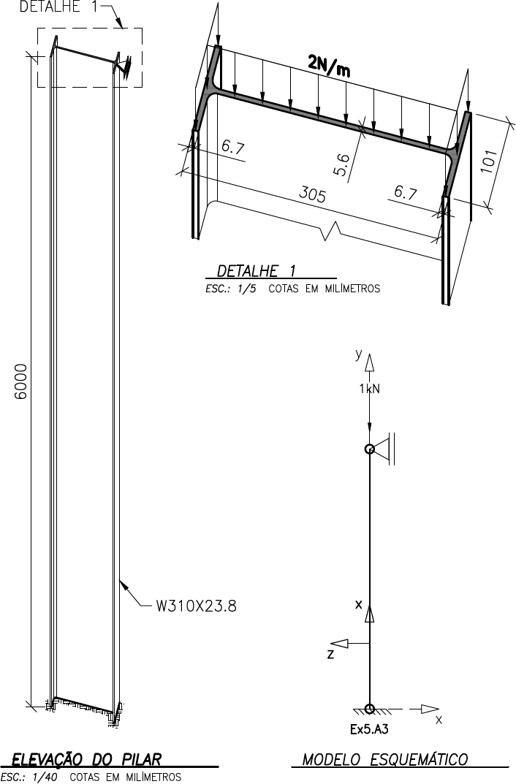

Slide 13
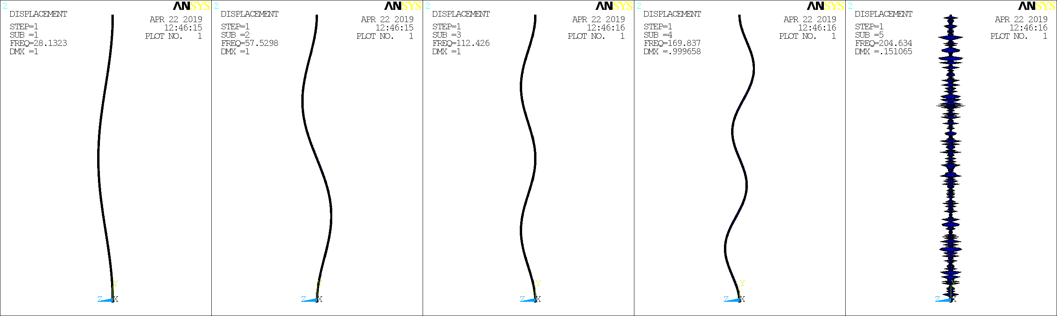
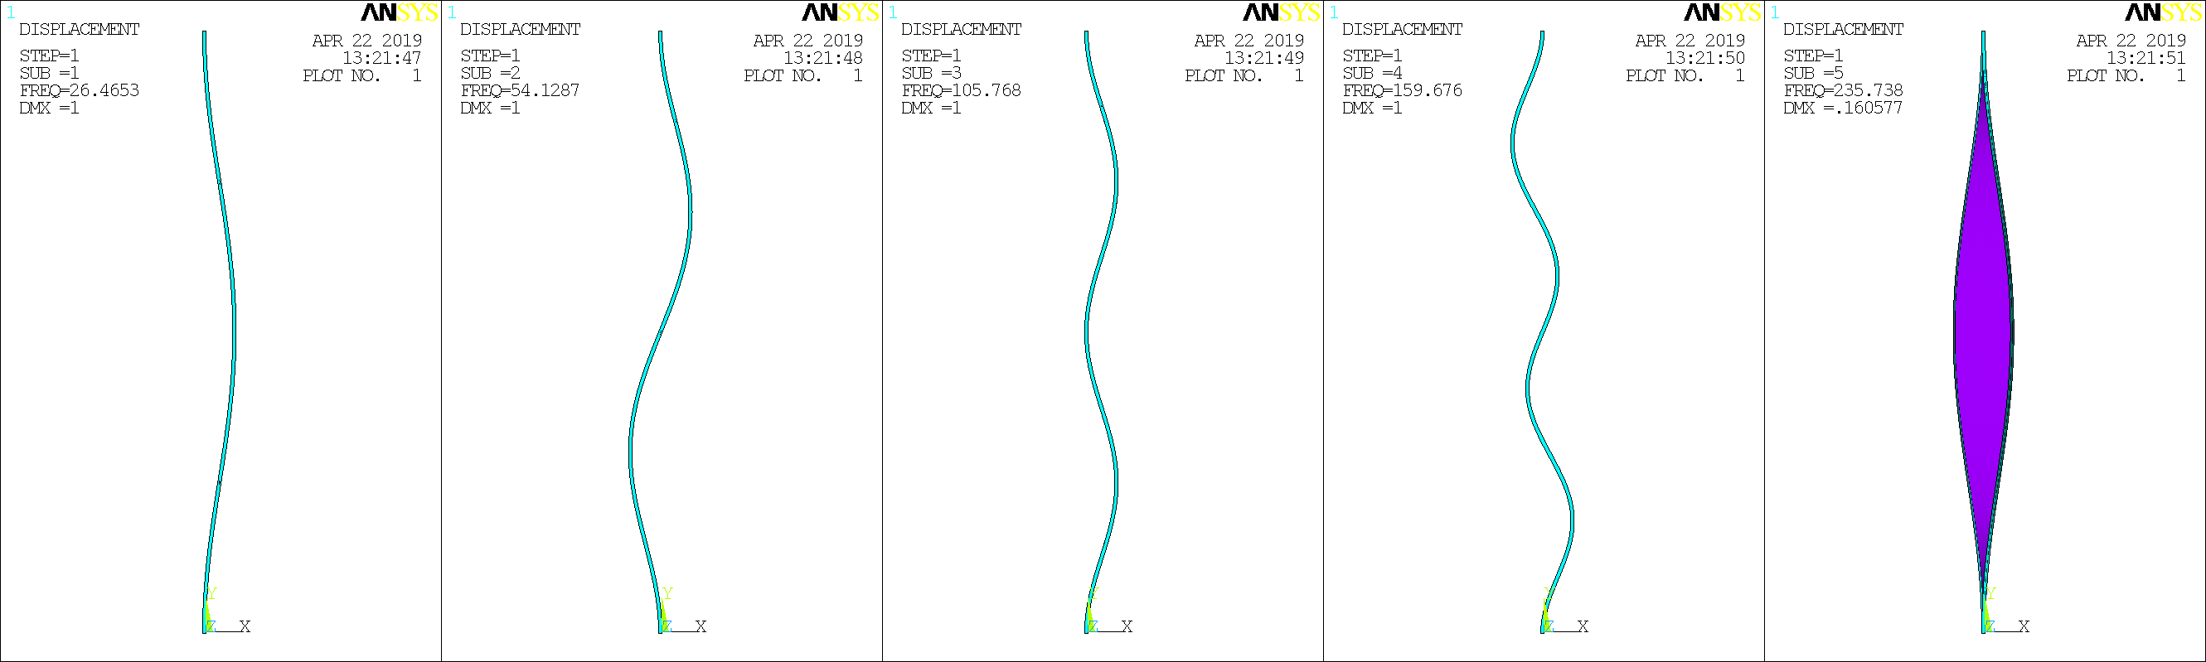
Ex5.A3 – BEAM188
FREQ=28.1323
FREQ=57.5298
FREQ=112.426
FREQ=169.837
FREQ=204.634
n=1
n=2
n=3
n=4
n=5
Ex5.C – SHELL181
FREQ=26.4653
FREQ=54.1287
FREQ=105.768
FREQ=159.676
FREQ=235.738
n=1
n=2
n=3
n=4
n=5

Slide 14
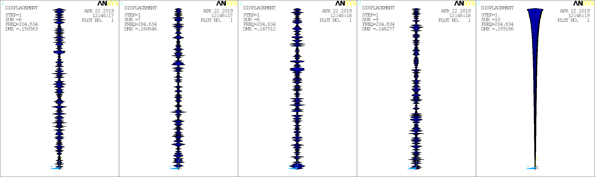
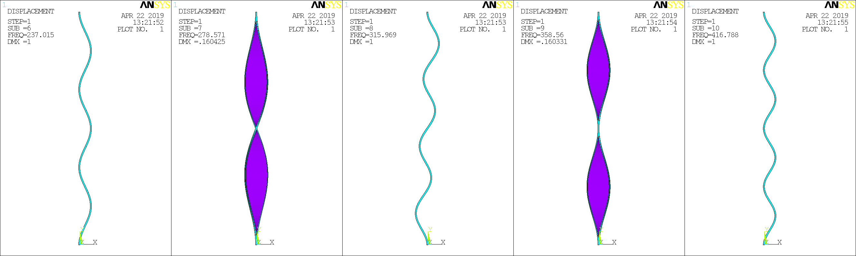
Ex5.A3 – BEAM188
FREQ=204.634
FREQ=204.634
FREQ=204.634
FREQ=204.634
FREQ=204.634
n=6
n=7
n=8
n=9
n=10
Ex5.C – SHELL181
FREQ=237.015
FREQ=278.571
FREQ=315.969
FREQ=358.560
FREQ=416.788
n=6
n=7
n=8
n=9
n=10

Slide 15
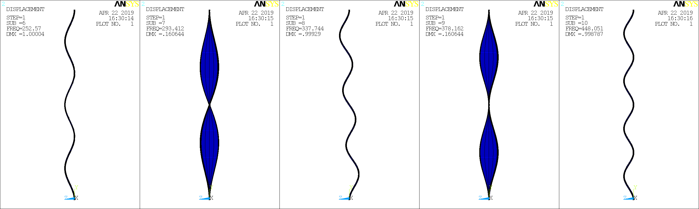
Ex5.A3 – BEAM188: KEYOPT(1)=1 INCLUDE WARPING
FREQ=252.570
FREQ=293.412
FREQ=337.744
FREQ=378.162
FREQ=448.051
n=6
n=7
n=8
n=9
n=10
Ex5.C – SHELL181
FREQ=237.015
FREQ=278.571
FREQ=315.969
FREQ=358.560
FREQ=416.788
n=6
n=7
n=8
n=9
n=10

Slide 16



Ex5.A3 – BEAM188
FREQ=28.123
FREQ=57.5298
FREQ=112.426
FREQ=169.837
FREQ=204.634
FREQ=204.634
FREQ=204.634
FREQ=204.634
FREQ=204.634
FREQ=204.634
Ex5.C – SHELL181
FREQ=26.4653
FREQ=54.1287
FREQ=105.768
FREQ=159.676
FREQ=235.738
FREQ=237.015
FREQ=278.571
FREQ=315.969
FREQ=358.560
FREQ=416.788
Ex5.A3 – BEAM188: KEYOPT(1)=1 INCLUDE WARPING
FREQ=28.1324
FREQ=57.5297
FREQ=112.426
FREQ=169.837
FREQ=248.041
FREQ=252.570
FREQ=293.412
FREQ=337.744
FREQ=378.162
FREQ=448.051

Slide 17


Ex5.C (modificado):
SHELL181;
Rotulado no topo;
L=6m;

Slide 18




n=1
P_{cr} = 385,3kN
n=2
P_{cr} = 929,2kN
n=3
P_{cr} = 1911,7kN
Ex5.B

